Slide 1

Unit – 7 Code Optimization
Compiler Design (CD)
GTU # 2170701
Prof. Dixita B. Kagathara
Computer Engineering Department
dixita.kagathara@darshan.ac.in
+91 - 97277 47317 (CE Department)

Slide 2
Topics to be covered
Optimization technique
Peephole optimization
Loops in flow graph
Global data flow analysis
Dataflow properties

Looping

Slide 3
Code Optimization
Front End
Intermediate Code
Code Generator
Target Program
Compiler can optimize
User can optimize

Slide 4
Optimization Techniques

Slide 5
Compile time evaluation
Compile time evaluation means shifting of computations from run time to compile time.
There are two methods used to obtain the compile time evaluation.
Folding
In the folding technique the computation of constant is done at compile time instead of run time.
Example : length = (22/7)*d
Here folding is implied by performing the computation of 22/7 at compile time.
Constant propagation
In this technique the value of variable is replaced and computation of an expression is done at compilation time.
Example : pi = 3.14; r = 5;
Area = pi * r * r;
Here at the compilation time the value of pi is replaced by 3.14 and r by 5 then computation of 3.14 * 5 * 5 is done during compilation.

Slide 6
Common sub expressions elimination
The common sub expression is an expression appearing repeatedly in the program which is computed previously.
If the operands of this sub expression do not get changed at all then result of such sub expression is used instead of re-computing it each time.
Example:
t1 := 4 * i
t2 := a[t1]
t3 := 4*j
t4 : = 4 * i
t5:= n
t6 := b[t4]+t5

Slide 7
Copy Propagation
Copy propagation means use of one variable instead of another.
Example:
x = pi;
area = x * r * r;
area = pi * r * r;

Slide 8
Code Motion
Optimization can be obtained by moving some amount of code outside the loop and placing it just before entering in the loop.
This method is also called loop invariant computation.
Example:
While(i<=max-1) { sum=sum+a[i]; } |  | N=max-1; While(i<=N) { sum=sum+a[i]; }

Slide 9
Reduction in Strength
priority of certain operators is higher than others.
For instance strength of * is higher than +.
In this technique the higher strength operators can be replaced by lower strength operators.
Example:
Here we get the count values as 7, 14, 21…. and so on.
for(i=1;i<=50;i++) { count = i*7; } |  | temp=7; for(i=1;i<=50;i++) { count = temp; temp = temp+7; }

Slide 10
Dead code elimination
The variable is said to be dead at a point in a program if the value contained into it is never been used.
The code containing such a variable supposed to be a dead code.
Example:
i=0;
if(i==1)
{
a=x+5;
}
If statement is a dead code as this condition will never get satisfied hence, statement can be eliminated and optimization can be done.
Dead Code

Slide 11
Peephole Optimization

Slide 12
Peephole optimization
Peephole optimization is a simple and effective technique for locally improving target code.
This technique is applied to improve the performance of the target program by examining the short sequence of target instructions (called the peephole) and replacing these instructions by shorter or faster sequence whenever possible.
Peephole is a small, moving window on the target program.

Slide 13
Redundant Loads & Stores
Especially the redundant loads and stores can be eliminated in following type of transformations.
Example:
MOV R0,x
MOV x,R0
We can eliminate the second instruction since x is in already R0.

Slide 14
Flow of Control Optimization
The unnecessary jumps can be eliminated in either the intermediate code or the target code by the following types of peephole optimizations.
We can replace the jump sequence.
It may be possible to eliminate the statement L1: goto L2 provided it is preceded by an unconditional jump. Similarly, the sequence can be replaced by:
Goto L1 …… L1: goto L2 |  | Goto L2
If a<b goto L1 …… L1: goto L2 |  | If a<b goto L2

Slide 15
Algebraic simplification
Peephole optimization is an effective technique for algebraic simplification.
The statements such as x = x + 0 or x := x* 1 can be eliminated by peephole optimization.

Slide 16
Reduction in strength
Certain machine instructions are cheaper than the other.
In order to improve performance of the intermediate code we can replace these instructions by equivalent cheaper instruction.
For example, x² is cheaper than x * x.
Similarly addition and subtraction are cheaper than multiplication and division. So we can add effectively equivalent addition and subtraction for multiplication and division.

Slide 17
Machine idioms
The target instructions have equivalent machine instructions for performing some operations.
Hence we can replace these target instructions by equivalent machine instructions in order to improve the efficiency.
Example: Some machines have auto-increment or auto-decrement addressing modes.
These modes can be used in code for statement like i=i+1.

Slide 18
Loops in Flow Graphs

Slide 19
Dominators
In a flow graph, a node d dominates n if every path to node n from initial node goes through d only.
This can be denoted as ’d dom n'.
Every initial node dominates all the remaining nodes in the flow graph.
Every node dominates itself.
Node 1 is initial node and it dominates every node as it is initial node.
Node 2 dominates 3, 4 and 5.
1
2
3
4
5

Slide 20
Natural Loops
There are two essential properties of natural loop:
A loop must have single entry point, called the header. This point dominates all nodes in the loop.
There must be at least one way to iterate loop.
6→1 is natural loop.
Header
1
2
3
4
5
6

Slide 21
Inner Loops
The inner loop is a loop that contains no other loop.
Here the inner loop is 4→2 that mean edge given by 2-3-4.
1
2
3
4
5

Slide 22

Preheader
Several transformation require us to move statements “before the header”.
Therefore begin treatment of a loop $L$ by creating a new block, called the preheader.
The preheader has only the header as successor.
Preheader
Header
B₀

Slide 23
Reducible Flow Graph
The reducible graph is a flow graph in which there are two types of edges forward edges and backward edges.
These edges have following properties,
The forward edge forms an acyclic graph.
The back edges are such edges whose head dominates their tail.
1
2
3
4
5

Slide 24
Nonreducible Flow Graph
A non reducible flow graph is a flow graph in which:
There are no back edges.
Forward edges may produce cycle in the graph.
1
2
3

Slide 25
Global Data Flow Analysis

Slide 26
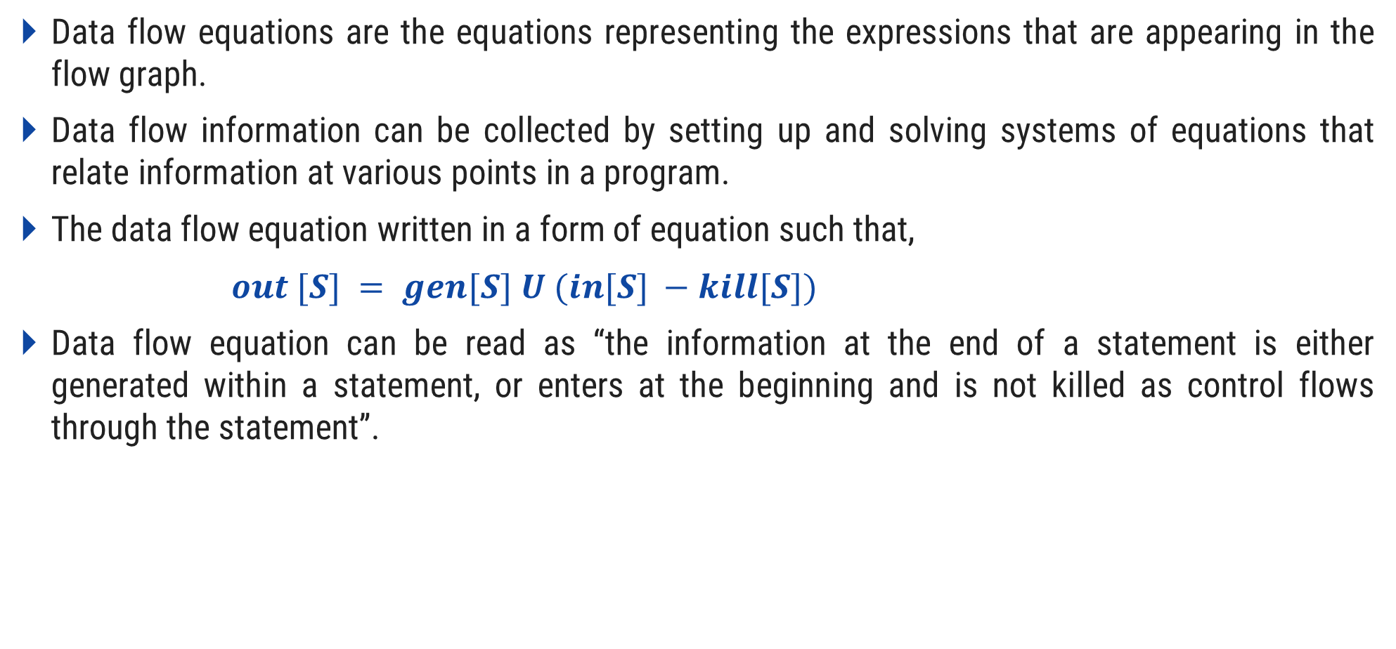
Global Data Flow Analysis
Data flow equations are the equations representing the expressions that are appearing in the flow graph.
Data flow information can be collected by setting up and solving systems of equations that relate information at various points in a program.
The data flow equation written in a form of equation such that,
$out [S] = gen[S] U (in[S] −kill[S])$
Data flow equation can be read as “the information at the end of a statement is either generated within a statement, or enters at the beginning and is not killed as control flows through the statement”.

Slide 27
Global Data Flow Analysis
The details of how dataflow equations are set up and solved depend on three factors.
The notions of generating, i.e., on the data flow analysis problem to be solved. Moreover, for some problems, instead of proceeding along with flow of control and defining out[s] in terms of in[s], we need to proceed backwards and define in[s] in terms of out[s].
g and killing depend on the desired information Since data flows along control paths, data-flow analysis is affected by the constructs in a program. In fact, when we write out[s] we implicitly assume that there is unique end point where control leaves the statement; in general, equations are set up at the level of basic blocks rather than statements, because blocks do have unique end points.
There are subtleties that go along with such statements as procedure calls, assignments through pointer variables, and even assignments to array variables.

Slide 28
Dataflow Properties

Slide 29
Data Flow Properties
A program point containing the definition is called Definition point.
A program point at which a reference to a data item is made is called Reference point.
A program point at which some evaluating expression is given is called Evaluation point.
W1:x=3
Definition point
W2: y=x
Reference point
W3: z=a*b
Evaluation point

Slide 30

Available Expression
An expression $x+y$ is available at a program point w if and only if along all paths are reaching to w.
The expression $x+y$ is said to be available at its evaluation point.
Neither of the two operands get modified before their use.
Expression $4 ∗ i$is the available expression for $B2$, $B3$ and $B4$ because this expression has not been changed by any of the block before appearing in $B4$.
B1: t1=4*i
B2: t2:c+d[t1]
B3: t3=4*i
B4: t4=a[t3]

Slide 31

Reaching Definition
A definition $D$ reaches at the point $P$ if there is a path from $D$ to $P$ along which $D$ is not killed.
A definition $D$ of variable $x$ is killed when there is a redefinition of $x$.
The definition $D1$ is reaching definition for block $B2$, but the definition $D1$ is not reaching definition for block $B3$, because it is killed by definition $D2$ in block $B2$.
D1: y=2
B1
D2: y=y+2
B2
D3: x=y+2
B3

Slide 32
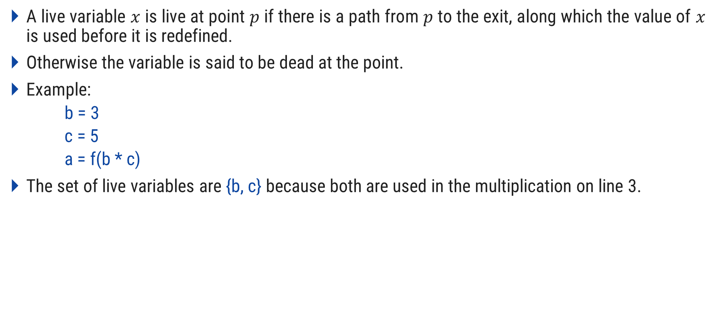
Live variable
A live variable $x$ is live at point $p$ if there is a path from $p$ to the exit, along which the value of $x$ is used before it is redefined.
Otherwise the variable is said to be dead at the point.
Example:
b = 3
c = 5
a = f(b * c)
The set of live variables are {b, c} because both are used in the multiplication on line 3.

Slide 33

Busy Expression
An expression $e$ is said to be busy expression along some path $pi..pj$if and only if an evaluation of $e$ exists along some path $pi…pj$ and no definition of any operand exist before its evaluation along the path.

Slide 34
Thank You

